Slide 1
AI 620 EMERGING TOPICS IN ARTIFICIAL INTELLIGENCE
Module 7
Topic Discovery in Text Collection

Slide 2
Learning outcomes
Reviewing topic modeling techniques
Understanding how the Neural Topic Model works
Training NTM in SageMaker
Deploying NTM and running inference

Slide 3
Reviewing topic modeling techniques
Linear techniques
Latent Semantic Analysis
Probabilistic Latent Semantic Analysis
Latent Dirichlet Allocation
Non-linear techniques
LDA2Vec
Neural Variational Document Model

Slide 4
Latent Semantic Analysis (LSA)
In its simplest form, the document word matrix consists of raw counts, which is the frequency with which a given word occurs in a given document. Since this approach doesn't account for the significance of each word in the document, we replace raw counts with the tf-idf (term frequency-inverse document frequency) score.
Through tf-idf, words that occur frequently within the document in question, but less frequently across all the other documents, will have a higher weight. Given that the matrix of documents and words is sparse and noisy, dimensionality must be reduced to obtain meaningful relationships between documents and words via topics.
Reducing dimensionality can be done through truncated SVD (Singular Value Decomposition), where the document-word matrix is broken down into three different matrices, that is, document topic (U), word-topic (V), and singular values matrix (S), where singular values represent the strength of the topics, as shown in the following diagram.

Slide 5
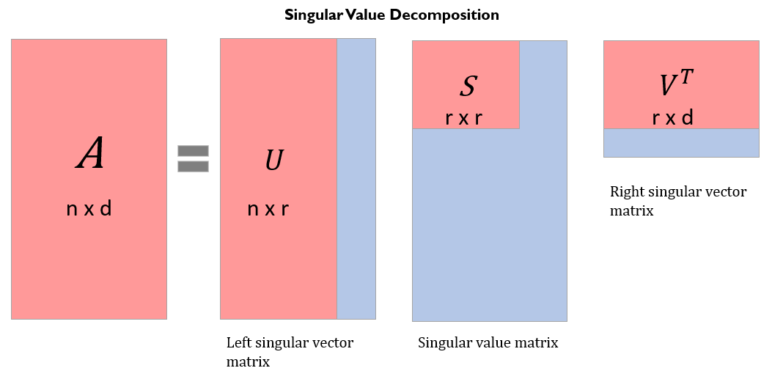
SVD (Singular Value Decomposition)

Slide 6
Non-negative matrix factorization (NMF)
Besides SVD, you can also conduct matrix factorization through (non-negative matrix factorization (NMF). NMF belongs to linear algebra algorithms and is used to identify a latent structure in the data. Two non-negative matrices are used to approximate the document-term matrix, as shown in the following diagram (terms and words are used interchangeably).

Slide 7
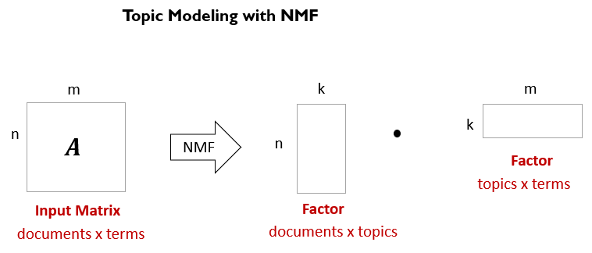
NMF

Slide 8
NMF VS SVD
The difference between NMF and SVD is that with SVD, we can end up with negative component (left and/or right) matrices, which is not natural for interpreting textual representation. NMF, on the other hand, generates non-negative representations for performing LSA.
The drawback of LSA, in general, is that it has fewer interpretable topics and a less efficient representation. Additionally, it is a linear model and cannot be used to model non-linear dependencies. The number of latent topics is limited by the rank of the matrix.

Slide 9
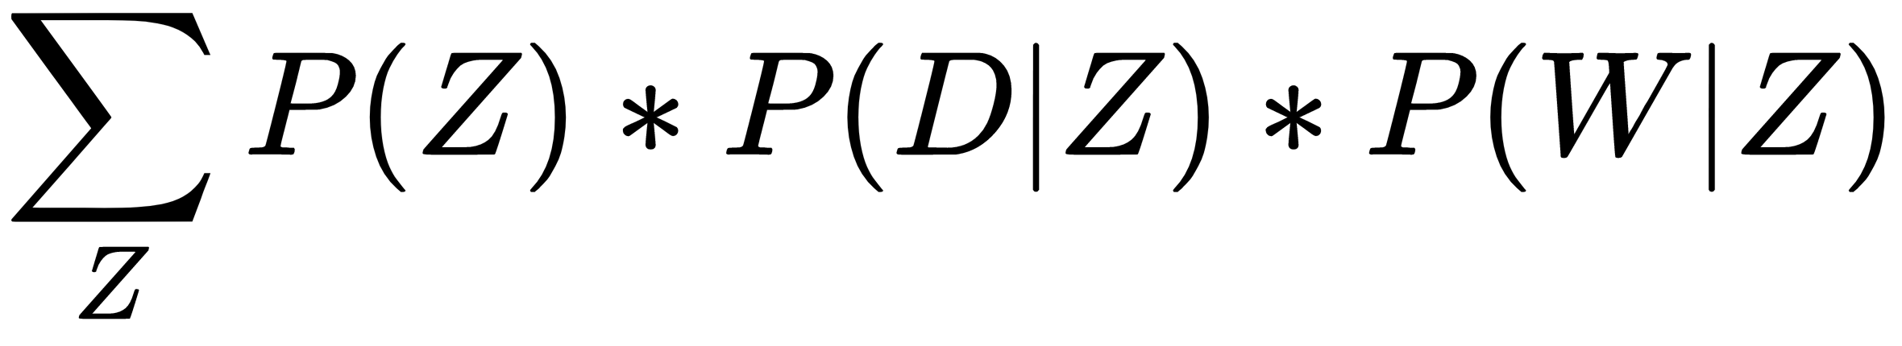
Probabilistic LSA (pLSA)
The whole idea of pLSA is to find a probabilistic model of latent topics that can generate documents and words we can observe. Therefore, the joint probability, that is, the probability of finding a combination of documents and words, , can be written as follows: P(D, W)=
Here, D=Document, W=Word, and Z=Topic

Slide 10
plsa
We can see how pLSA is similar to LSA in that P(Z) corresponds to a singular value matrix, P(D|Z) corresponds to a left singular vector, and P(W|Z) corresponds to a right singular vector from SVD.
The number one disadvantage with this approach is that we cannot readily generalize it for new documents. LDA addresses this issue.

Slide 11
Latent Dirichlet allocation (LDA)
While LSA and pLSA are used for semantic analysis or information retrieval, LDA is used for topic mining. In simple terms, you uncover topics based on the word frequency across a collection of documents.

Slide 12
Lda2vec and nvdm
Lda2vec is a superset of word2vec and LDA models. It is a variation of the skip-gram word2vec model. Lda2Vec can be used for a variety of applications, such as predicting contextual words given a word (known as a pivot or target word), including learning topic vectors for topic modeling.
Lda2vec is similar to Neural Variational Document Models (NVDM) in terms of producing topic embeddings or vectors. However, NVDM adopts a much cleaner and flexible approach to topic modeling by creating document vectors using neural networks, where a word-to-word relationship is completely disregarded.
NVDM (Neural Variational Document Model) is a flexible generative document modeling process where we learn about multiple representations of documents through topics (hence the word variational—meaning multiple—in NVDM).

Slide 13
nvdm
NVDM is based on the Variational Autoencoder (VAE) framework, which uses one neural network to encode (that is, an encoder) a collection of documents and a second one to decode (that is, a decoder) the compressed representation of documents. The goal of this process is to look at the best way to approximate information in a corpus. The autoencoder is optimized by minimizing two types of losses:
Loss with Decoding (the reconstruction error): Reconstruct the original document from topic embeddings.
Loss with Encoding (the Kullback Leibler or KL Divergence): Build a stochastic representation of the input document or topic embeddings. KL divergence measures information that's lost when encoding a bag-of-words representation of documents.

Slide 14
Understanding how the neural topic model works
The Neural Topic Model (NTM), as we described previously, is a generative document model that produces multiple representations of a document. It generates two outputs:
The topic mixture for a document.
A list of keywords that explain a topic, for all the topics across an entire corpus.
NTM is based on the Variational Autoencoder architecture.

Slide 15
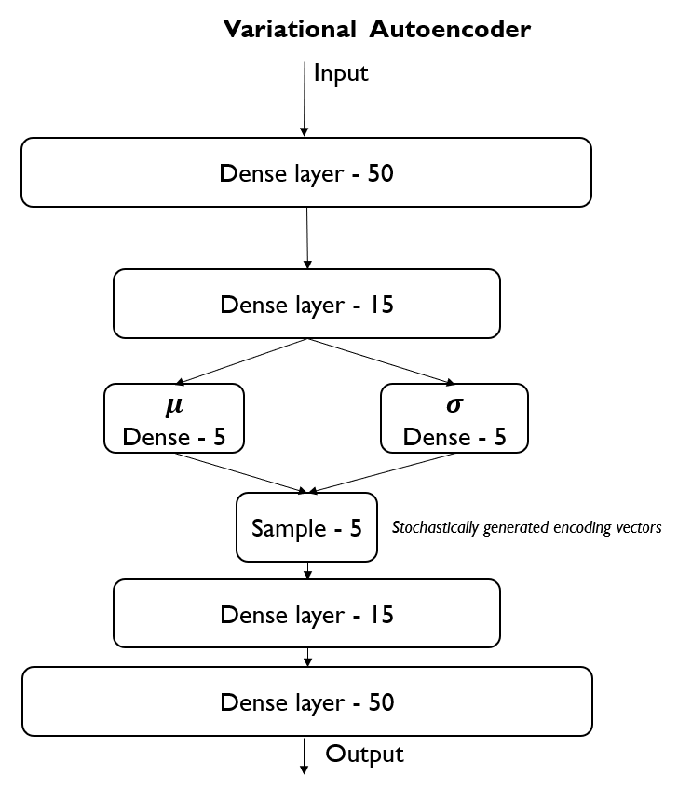
NTM

Slide 16
Training ntm in sagemaker
PE07-1 Data
Textbook 304 to get Enron emails
39.861 emails and 28101 unique words
We will work with a subset of these emails – 3986 emails and 17524 unique words
PE07-2 Implementation in SageMaker
Follow textbook page 311 step 1 to 13
PE07-3 Deploy the trained NTM model and running the inference
Follow textbook page 317 step 1 to 5, and plot the topics
DONE!

Slide 17
Model evaluation metrics
Word Embedding Topic Coherence Metric (WETC)
Topic Uniquencess (TU)
Perplexity (logppx)
Total Loss (total)
Kullback-Leibler Divergence loss (kld)
Reconstruction loss (recons)

Slide 18
References
Tripuraneni, S., & Song, C. (2019). Hands-On Artificial Intelligence on Amazon Web Services. Packt Publishing. https://learning.oreilly.com/library/view/hands-on-artificial-intelligence/9781789534146/

